Slide 1
Object-Oriented Software Engineering Practical Software Development using UML and Java
Modelling with Classes
Class Diagram

Slide 2
What is UML?
The Unified Modelling Language is a standard graphical language for modelling object oriented software
At the end of the 1980s and the beginning of 1990s, the first object-oriented development processes appeared
The proliferation of methods and notations tended to cause considerable confusion
Two important methodologists Rumbaugh and Booch decided to merge their approaches in 1994.
They worked together at the Rational Software Corporation
In 1995, another methodologist, Jacobson, joined the team
His work focused on use cases
In 1997 the Object Management Group (OMG) started the process of UML standardization

Slide 3
UML diagrams
Class diagrams
describe classes and their relationships
Interaction diagrams
show the behaviour of systems in terms of how objects interact with each other
State diagrams and activity diagrams
show how systems behave internally
Component and deployment diagrams
show how the various components of systems are arranged logically and physically

Slide 4
What constitutes a good model?
A model should
use a standard notation
be understandable by clients and users
lead software engineers to have insights about the system
provide abstraction
Models are used:
to help create designs
to permit analysis and review of those designs.
as the core documentation describing the system.

Slide 5
Essentials of UML Class Diagrams
The main symbols shown on class diagrams are:
Classes
represent the types of data themselves
Associations
represent linkages between instances of classes
Attributes
are simple data found in classes and their instances
Operations
represent the functions performed by the classes and their instances
Generalizations
group classes into inheritance hierarchies

Slide 6
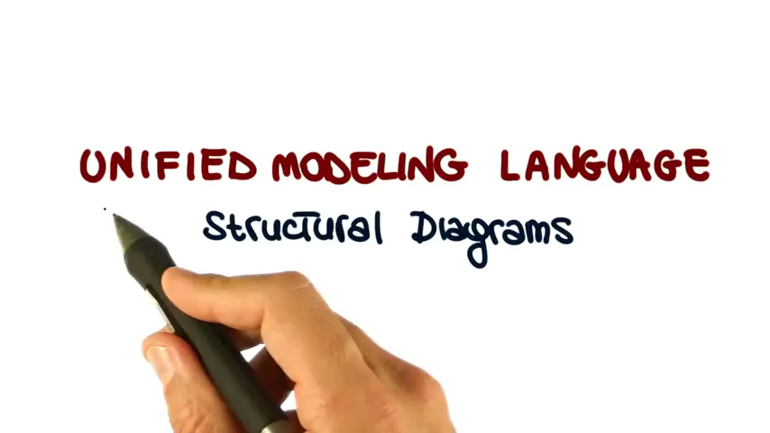
Video – UML Structural Diagrams

Slide 7
Classes
A class is simply represented as a box with the name of the class inside
The diagram may also show the attributes and operations
The complete signature of an operation is:
operationName(parameterName: parameterType …): returnType
Rectangle
Rectangle
Rectangle
Rectangle
Rectangle
getArea
height
height
height: int
resize
width
width
width: int
getArea
getArea(): int
resize
resize(int,int)

Slide 8
Relationships
Dependency
While dependency may have broad meaning, it is best not to overuse the dependency relationship
Association
Aggregation
Composition
Generalization
Implementation (interfaces)

Slide 9

Video – Relationships in class diagram

Slide 10
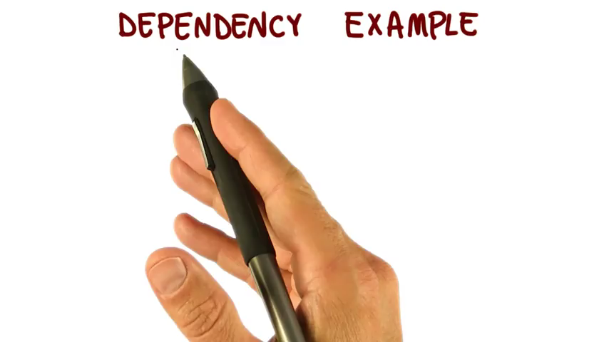
Video – Dependency in class diagram
Notes:
So what should a dependency relationship represent? In our UML example above the dependency means that class A uses class B, but that class A does not contain an instance of class B as part of its own state. It also means that if class B’s interface changes it will likely impact class A and require it to change. I suggest that you constrain your use of dependency relationships to non-state related concerns. You would use dependency to indicate that, for example, class A receives an instance of class B as a parameter to at least one of its methods. You would also use dependency to indicate that class A creates an instance of class B local to one of its methods (on the stack). You would not, however, use dependency to indicate that class A declares an instance variable of class B, as that would indicate a state-related concern. Again, use association to do that (covered next).

Slide 11
Associations and Multiplicity
An association is used to show how two classes are related to each other
Symbols indicating multiplicity are shown at each end of the association

Slide 12
Labelling associations
Each association can be labelled, to make explicit the nature of the association

Slide 13
Analyzing and validating associations
Many-to-one
A company has many employees,
An employee can only work for one company.
This company will not store data about the moonlighting activities of employees!
A company can have zero employees
E.g. a ‘shell’ company
It is not possible to be an employee unless you work for a company

Slide 14
Analyzing and validating associations
Many-to-many
A secretary can work for many managers
A manager can have many secretaries
Secretaries can work in pools
Managers can have a group of secretaries
Some managers might have zero secretaries.

Slide 15
Analyzing and validating associations
One-to-one
For each company, there is exactly one board of directors
A board is the board of only one company
A company must always have a board
A board must always be of some company

Slide 16
Analyzing and validating associations
Avoid unnecessary one-to-one associations
Avoid this do this

Slide 17
A more complex example
A booking is always for exactly one passenger
no booking with zero passengers
a booking could never involve more than one passenger.
A Passenger can have any number of Bookings
a passenger could have no bookings at all
a passenger could have more than one booking

Slide 18
Association classes
Sometimes, an attribute that concerns two associated classes cannot be placed in either of the classes
The following are equivalent
*
*
*
*
*
*
Student
*
CourseSection
Registration
grade
Student
*
Registration
*
CourseSection
grade

Slide 19
Reflexive associations
It is possible for an association to connect a class to itself
successor
*
*
Course
isMutuallyExclusiveWith
*
*
prerequisite

Slide 20
Directionality in associations
Associations are by default bi-directional
Bi-directional associations are navigable from both ends.
It is possible to limit the direction of an association by adding an arrow at one end.
The arrowhead means that there is a one-way relationship.
Day
*
Note

Slide 21
Generalization
Specializing a superclass into two or more subclasses
The discriminator is a label that describes the criteria used in the specialization

Slide 22
Avoiding unnecessary generalizations
Inappropriate hierarchy of
classes, which should be
Instances !
Recording
*
hasCategory
RecordingCategory
Improved class diagram,
with its corresponding
instance diagram
title
description
*
subcategory
artist
:RecordingCategory
:RecordingCategory
video
audio
subcategory
subcategory
subcategory
subcategory
subcategory
:RecordingCategory
:RecordingCategory
:RecordingCategory
:RecordingCategory
:RecordingCategory
music video
jazz
classical
blues
rock
:Recording
:Recording
9th Symphony
Let it be
Beethoven
The Beatles

Slide 23
Instance Diagrams
A link is an instance of an association
In the same way that we say an object is an instance of a class
Pat:Employee
Wayne:Employee
OOCorp:Company
OOCorp's Board:
Ali:Employee
Carla:Employee
UML inc:Company
UML inc's Board
Terry:Employee

Slide 24
Associations versus Generalizations in instance diagrams
Associations describe the relationships that will exist between instances at run time.
When you show an instance diagram generated from a class diagram, there will be an instance of both classes joined by an association (link)
Generalizations describe relationships between classes in class diagrams.
They do not appear in instance diagrams at all.
An instance of any class should also be considered to be an instance of each of that class’s superclasses .

Slide 25
More Advanced Features: Aggregation
Aggregations are special associations that represent ‘part-whole’ relationships.
The ‘whole’ side is often called the assembly or the aggregate
This symbol is a shorthand notation association named isPartOf
*
*
*
Vehicle
*
VehiclePart
*
*
*
*
*
Country
*
Region
The aggregation link is usually used to stress the point that Class A instance is not the exclusive container of Class B instance, as in fact the same Class B instance has another container/s.
Notes:
It's important to note that the aggregation link doesn't state in any way that Class A owns Class B nor that there's a parent-child relationship (when parent deleted all its child's are being deleted as a result) between the two. Actually, quite the opposite! The aggregation link is usually used to stress the point that Class A instance is not the exclusive container of Class B instance, as in fact the same Class B instance has another container/s.

Slide 26
When to use an aggregation
As a general rule, you can mark an association as an aggregation if the following are true:
You can state that
the parts ‘are part of’ the aggregate
or the aggregate ‘is composed of’ the parts
When something owns or controls the aggregate, then they also own or control the parts

Slide 27
Composition
A composition is a strong kind of aggregation
if the aggregate is destroyed, then the parts are destroyed as well
Two alternatives for addresses
*
*
*
*
Building
*
Room
Notes:
Composition is actually a special case of the aggregation relationship. Aggregation models
has-a relationships and represents an ownership relationship between two objects. The owner
object is called an aggregating object and its class an aggregating class. The subject object is
called an aggregated object and its class an aggregated class.
An object may be owned by several other aggregating objects. If an object is exclusively
owned by an aggregating object, the relationship between them is referred to as
composition. For example, “a student has a name” is a composition relationship between
the Student class and the Name class, whereas “a student has an address” is an aggregation
relationship between the Student class and the Address class, because an address
may be shared by several students.

Slide 28
Aggregation hierarchy
Vehicle
*
*
Chassis
BodyPanel
Door
*
Frame
Engine
Transmission
Wheel

Slide 29
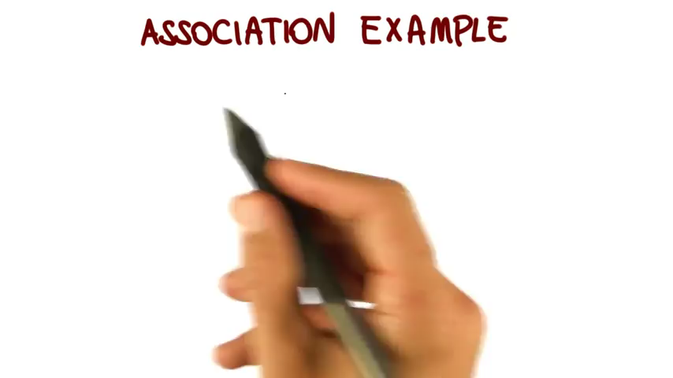
Video – Association and Aggregation in class diagram

Slide 30

Video – Generalization in class diagram

Slide 31
Interfaces
An interface describes a portion of the visible behaviour of a set of objects.
An interface is similar to a class, except it lacks instance variables and implemented methods
Person
«interface»
Machine
Person
Machine
Cashier
withdraw
Cashier
Cashier
deposit
Employee
ATM
Employee
ATM

Slide 32
Notes and descriptive text
Descriptive text and other diagrams
Embed your diagrams in a larger document
Text can explain aspects of the system using any notation you like
Highlight and expand on important features, and give rationale
Notes:
A note is a small block of text embedded in a UML diagram
It acts like a comment in a programming language

Slide 33
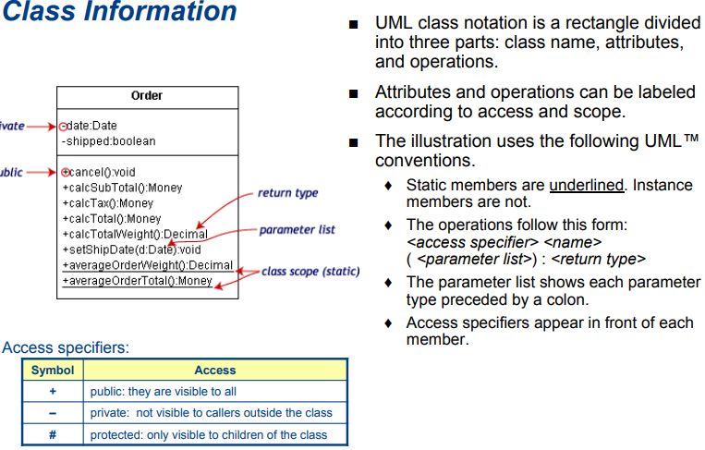
Class Information

Slide 34
Suggested sequence of activities
Identify a first set of candidate classes
Add associations and attributes
Find generalizations
List the main responsibilities of each class
Decide on specific operations
Iterate over the entire process until the model is satisfactory
Add or delete classes, associations, attributes, generalizations, responsibilities or operations
Identify interfaces
Apply design patterns (Later on..)
Don’t be too disorganized. Don’t be too rigid either.

Slide 35
Identifying classes
When developing a domain model you tend to discover classes
When you work on the user interface or the system architecture, you tend to invent classes
Needed to solve a particular design problem
Reuse should always be a concern
Frameworks
System extensions
Similar systems

Slide 36
A simple technique for discovering domain classes
Look at a source material such as a description of requirements
Extract the nouns and noun phrases
Eliminate nouns that:
are redundant
represent instances
are vague or highly general
not needed in the application
Pay attention to classes in a domain model that represent types of users or other actors

Slide 37
Identifying associations and attributes
Start with classes you think are most central and important
Decide on the clear and obvious data it must contain and its relationships to other classes.
Avoid adding many associations and attributes to a class
A system is simpler if it manipulates less information

Slide 38
Tips about identifying and specifying valid associations
An association should exist if a class
possesses
controls
is connected to
is related to
is a part of
has as parts
is a member of, or
has as members
some other class in your model
Specify the multiplicity at both ends
Label it clearly.

Slide 39
Actions versus associations
A common mistake is to represent actions as if they were associations
LibraryPatron
*
*
*
*
*
*
LibraryPatron
borrow
return
Loan
*
borrowedDate
*
*
dueDate
*
CollectionItem
CollectionItem
returnedDate
Better: The
borrow
operation creates a
, and
Loan
Bad, due to the use of associations
the
return
operation sets the
returnedDate
that are actions
attribute.

Slide 40
Identifying attributes
Look for information that must be maintained about each class
Several nouns rejected as classes, may now become attributes
An attribute should generally contain a simple value
E.g. string, number

Slide 41
Tips about identifying and specifying valid attributes
It is not good to have many duplicate attributes
If a subset of a class’s attributes form a coherent group, then create a distinct class containing these attributes

Slide 42
An example (attributes and associations)
Employee
Passenger
RegularFlight
name
*
name
employeeNumber
time
number
jobFunction
supervisor
flightNumber
*
*
*
*
*
*
*
*
*
*
*
*
*
*
*
*
*
*
*
Booking
*
*
*
*
*
*
SpecificFlight
seatNumber
date

Slide 43
Identifying generalizations and interfaces
There are two ways to identify generalizations:
bottom-up
Group together similar classes creating a new superclass
top-down
Look for more general classes first, specialize them if needed
Create an interface, instead of a superclass if
The classes are very dissimilar except for having a few operations in common
One or more of the classes already have their own super classes
Different implementations of the same class might be available

Slide 44
An example (generalization)
0..2
Person
0..2
0..2
0..2
0..2
PersonRole
0..2
name
idNumber
RegularFlight
*
EmployeeRole
time
PassengerRole
jobFunction
supervisor
flightNumber
*
*
*
*
*
*
*
*
*
*
*
*
*
*
*
*
*
*
*
Booking
*
*
*
*
*
*
SpecificFlight
seatNumber
date

Slide 45
Allocating responsibilities to classes
A responsibility is something that the system is required to do.
Each functional requirement must be attributed to one of the classes
All the responsibilities of a given class should be clearly related.
If a class has too many responsibilities, consider splitting it into distinct classes
If a class has no responsibilities attached to it, then it is probably useless
When a responsibility cannot be attributed to any of the existing classes, then a new class should be created
To determine responsibilities
Perform use case analysis
Look for verbs and nouns describing actions in the system description

Slide 46
Categories of responsibilities
Setting and getting the values of attributes
Creating and initializing new instances
Loading to and saving from persistent storage
Destroying instances
Adding and deleting links of associations
Copying, converting, transforming, transmitting or outputting
Computing numerical results
Navigating and searching
Other specialized work

Slide 47
Identifying operations
Operations are needed to realize the responsibilities of each class
There may be several operations per responsibility
The main operations that implement a responsibility are normally declared public
Other methods that collaborate to perform the responsibility must be as private as possible

Slide 48
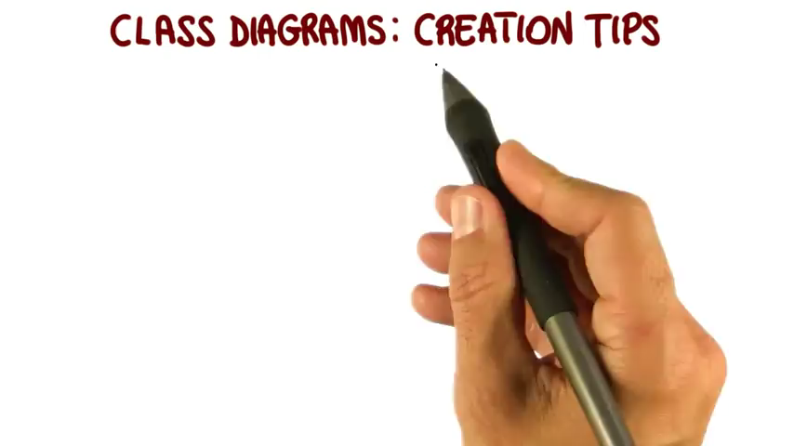
Video – Class diagram creation tips

Slide 49
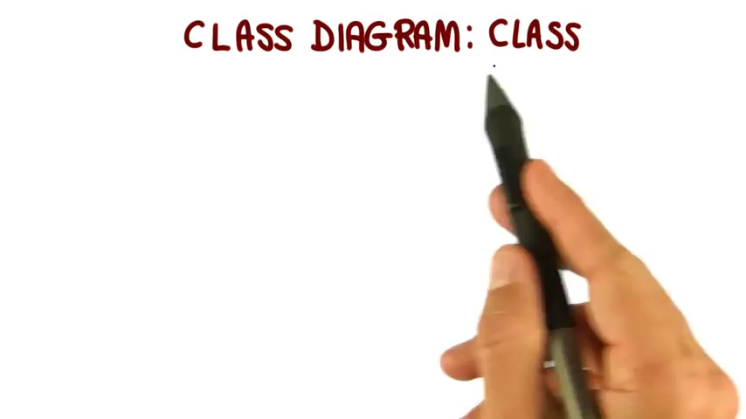
Video – Classes in class diagram

Slide 50

Video – Attributes in class diagram

Slide 51
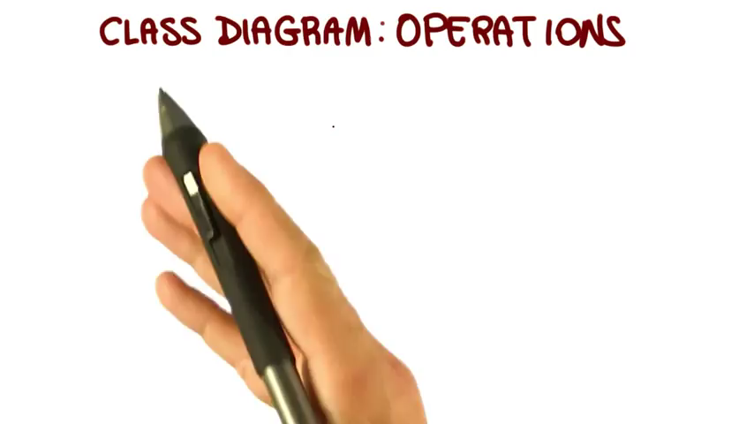
Video – Operation in class diagram

Slide 52
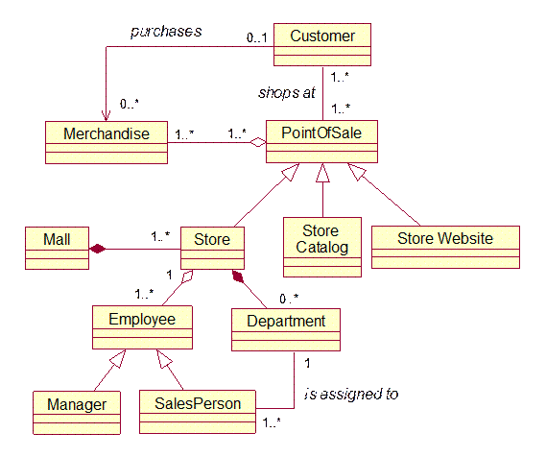
Example Class Diagram

